Slide 1
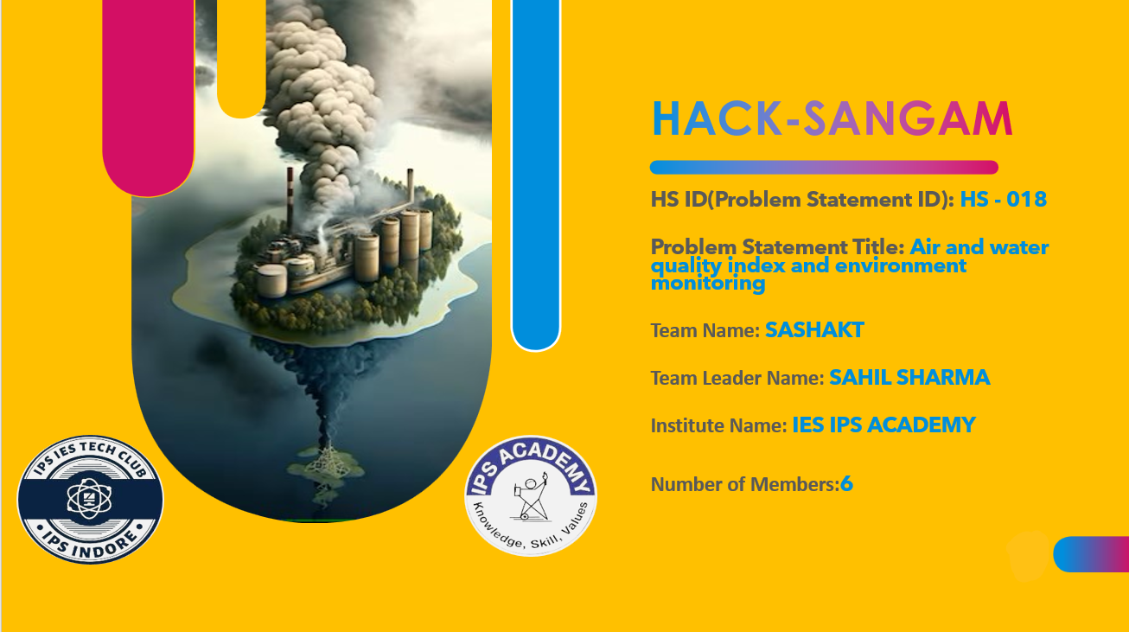

Slide 2
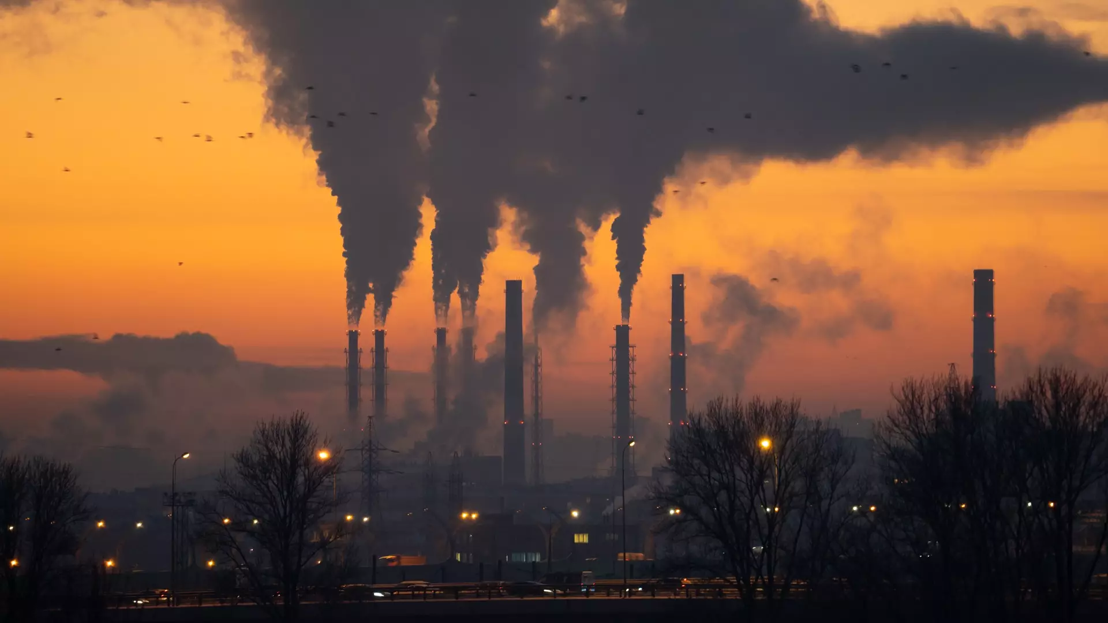

IDEA / TECH STACK /APPROACH

Slide 3
IDEA
Our website will serve as a comprehensive platform for users to access real-time data on air and water quality index in their area. It will provide users with tools to :
Understand the impact of pollution on their health and the environment.
Understand the cause of pollution by looking at the major pollutants.
Protect themselves with the health advisory .
Compare among the pollution levels of various areas.

Slide 4




TECH STACK
HTML
CSS
API
PLUGINS
JS

Slide 5

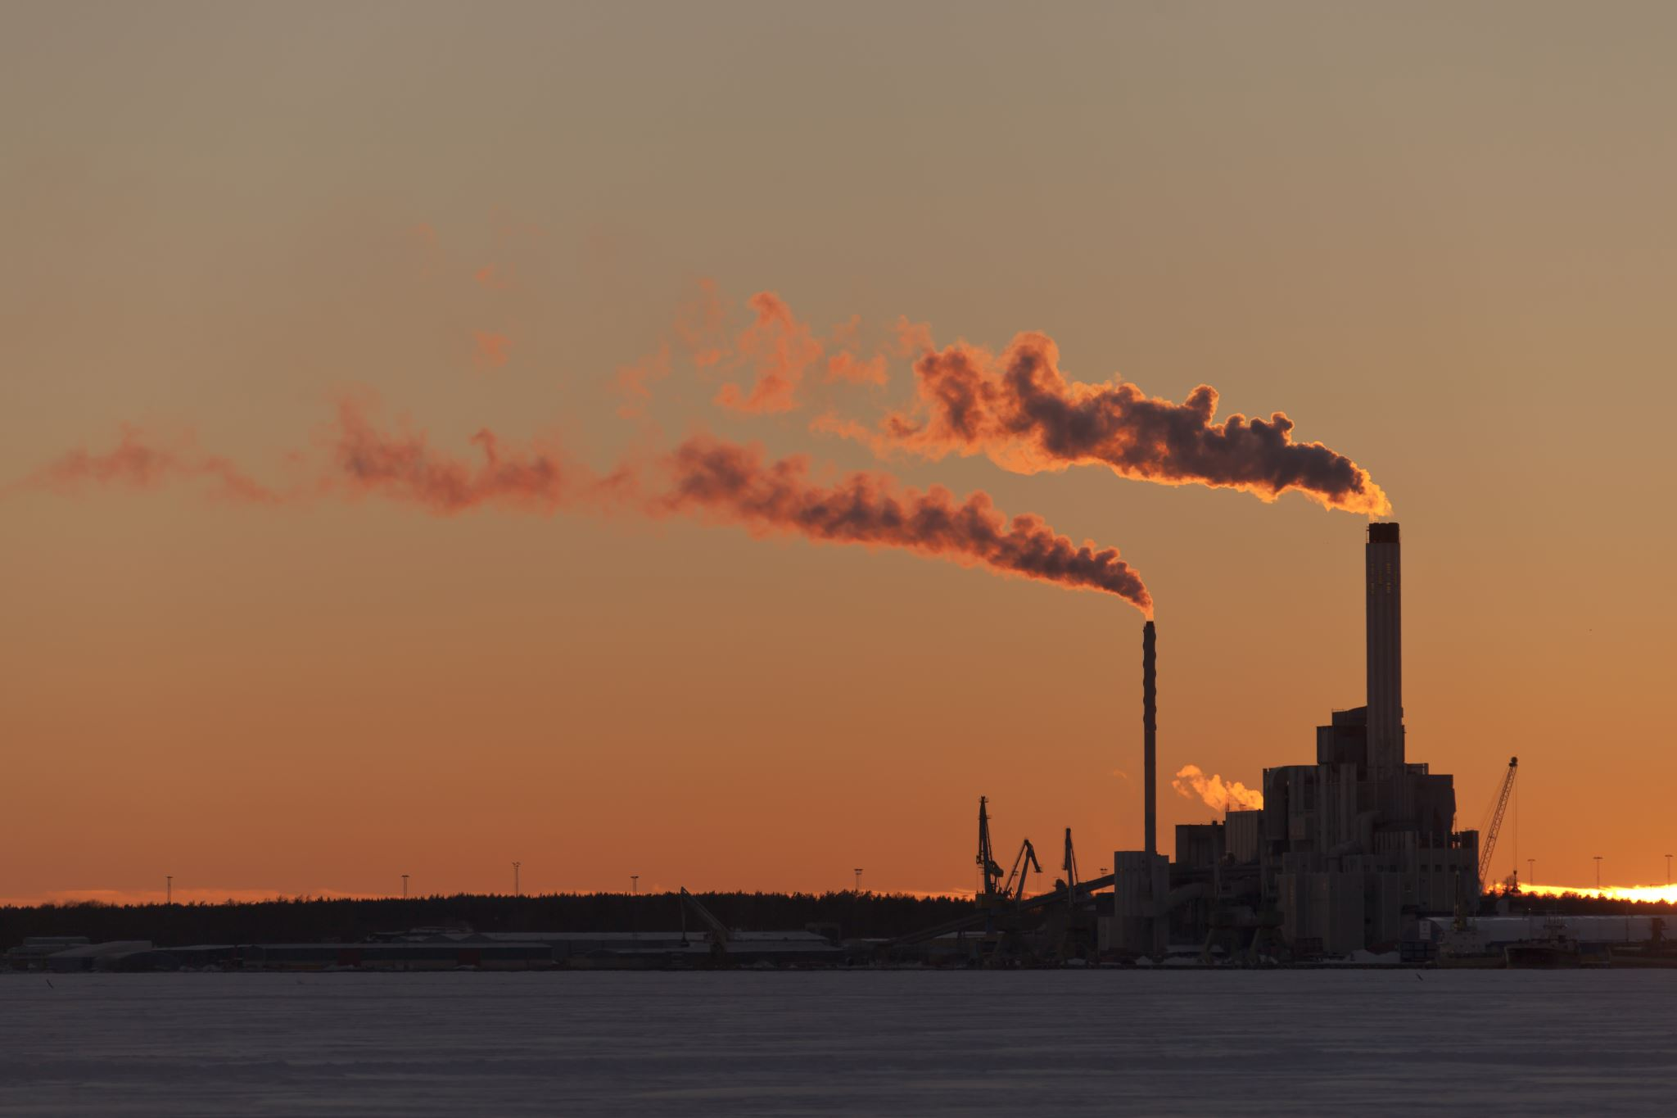












APPROACH/PROTOTYPE
ENTER CITY
AQI
Major Air Pollutants in Indore
INDORE(LIVE AIR QUALITY INDEX (AQI))
48
14(PM 2.5)
10(NO2)
10(SO2)
Real –time PM2.5,PM10 air pollution levels
GOOD
10(Ozone)
10(PM10)
10(CO)
Last update:08 March 2024(05:10 pm)
METRO CITIES AQI
NEW DELHI
(160)
AHMEDABAD
(107)
MUMBAI
(114)
CHENNAI
(71)
KOLKATA
(133)

Slide 6




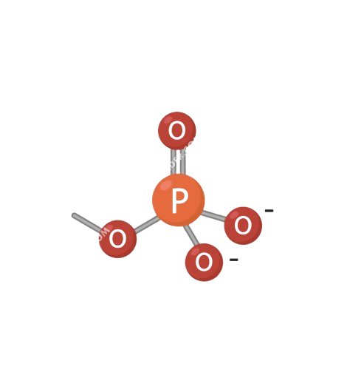
WQI
ENTER CITY
Major water pollutants in Indore
INDORE WATER QUALITY INDEX
(WQI)
Real-time DO, pH Water pollution levels
0.08(Turbidity)
0.17(DO)
GOOD
Last update:08 March 2024(05:10 pm)
0.11(pH)
0.1(Phosphate)
METRO CITIES WQI
NEW DELHI
(40)
AHMEDABAD
(25)
MUMBAI
(34)
CHENNAI
(51)
KOLKATA
(73)

Slide 7
